Slide 1

Welcome to the Dunlap Lake Annual Meeting
Dunlap Lake Annual Meeting
Monday, February 24, 2025

Slide 2
BOARD MEMBER INTRODUCTIONS
& WELCOME
Thank you to all volunteers and donors
Introduction of 2024 Board Members.
Andy Leek
Lori Scarlett
Roy Wehling
Josh Schumacher
Graham Johnson
Jim Taylor - VP
Richard Welle - Treasurer
Frank Gremaud
Ben Richey
Andrew Reznack - President
Expiring Terms
Mike Mosella
Toby Heddinghaus - Secretary
Terry Reising
Erik Manning
John Bode
C. Green and Associates
Carolyn Green
Maureen Bode

Slide 3
Welcome Guests
Jennifer Warren – Ward 6
Will Kraus – Ward 5

Slide 4
AGENDA
Election of New Board Members
Highlights from committee slide show
2025-26 Proposed Budget
  Operations
  Capital Budget
Master Plan Committee Update
  Lake Mapping
  Capital Programs
Goal update
Resident Question and Answer Time

Slide 5
ELECTION OF NEW
BOARD MEMBERS
Frank Gremaud - chair
Meetings, elections and social committee

Slide 6
Volunteered for Board Service
Term running 2025-28
  John Bode
  Terry Reising
  Todd McClew
  Mark Olson

Slide 7
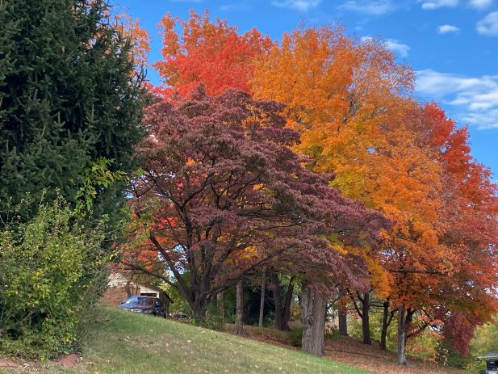
Dunlap Lake Committees
A Year in Review

Slide 8
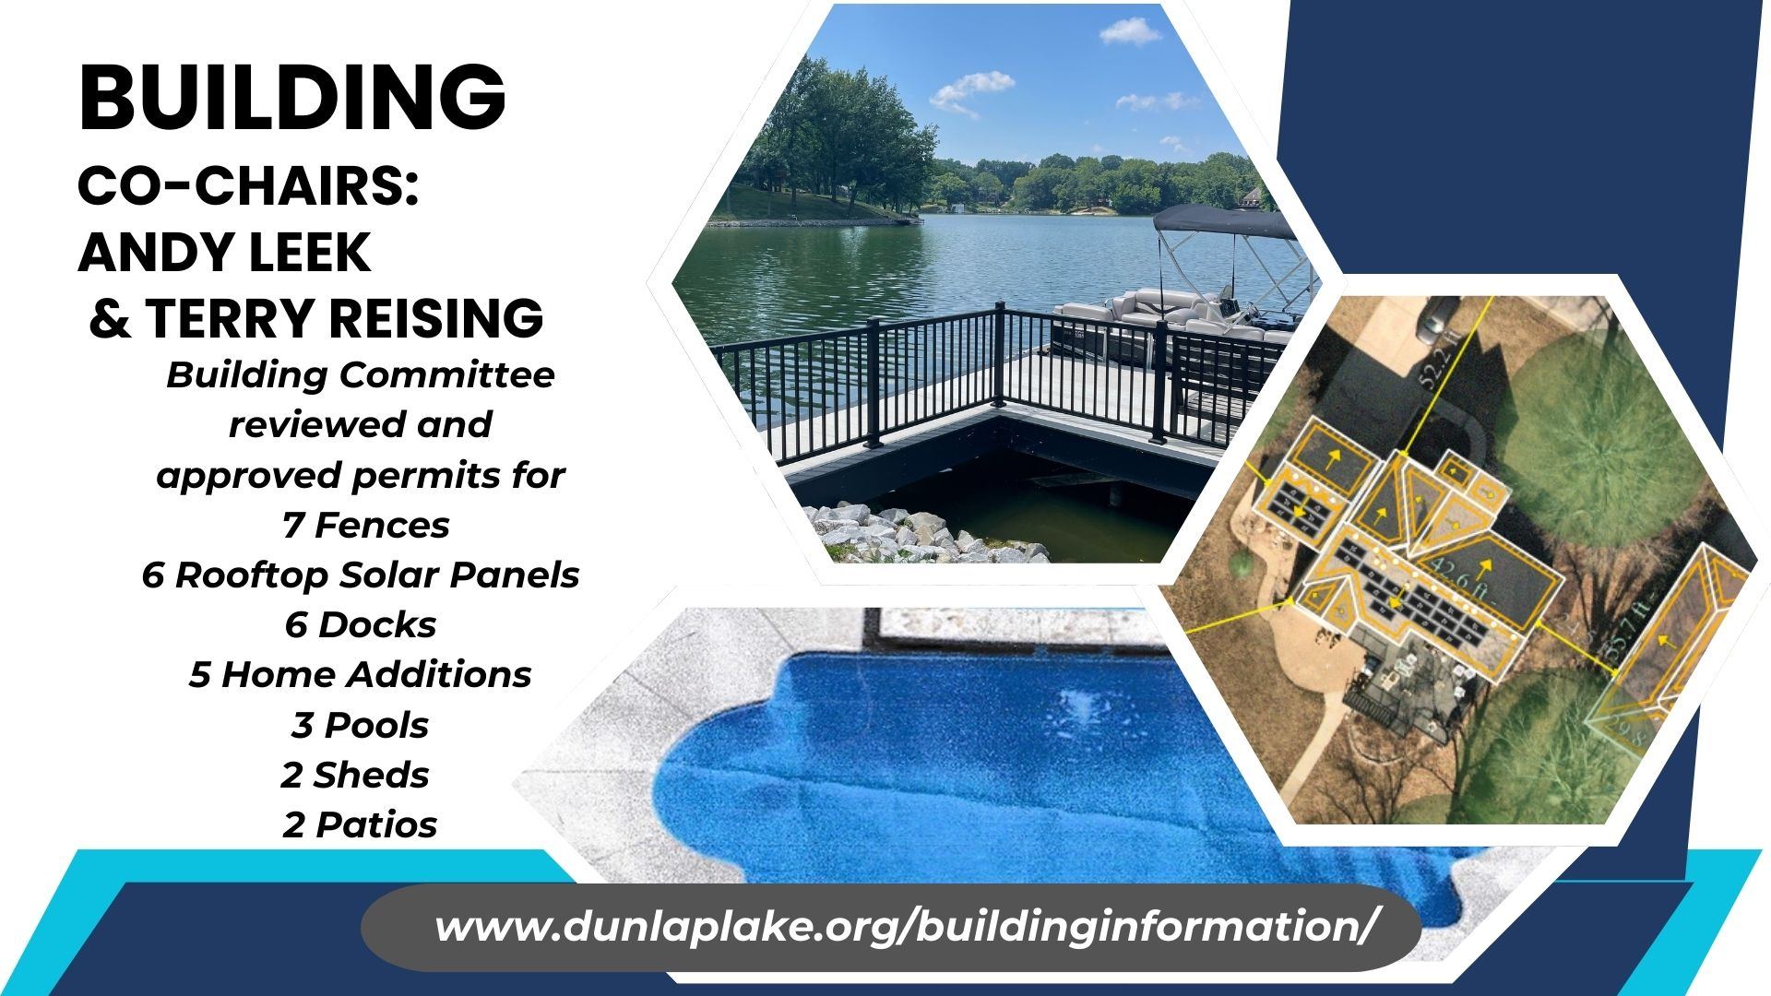

Slide 9
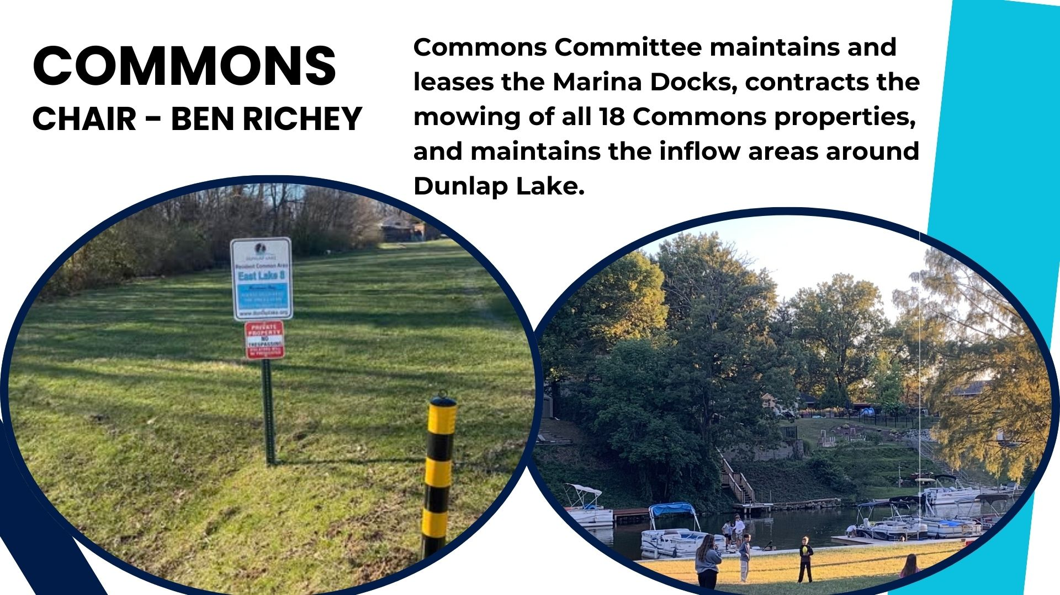

Slide 10


Slide 11

COMMUNICATIONS COMMITTEE
Merged with Social
Official announcements posted on signboards at
- 840 East Lake Drive
- Corner of Barnett and Schwarz
Volunteers are needed to help with:
  Posting/decorating Barnett Signboard
  Updating website
  Social media
  Welcoming new members

Slide 12
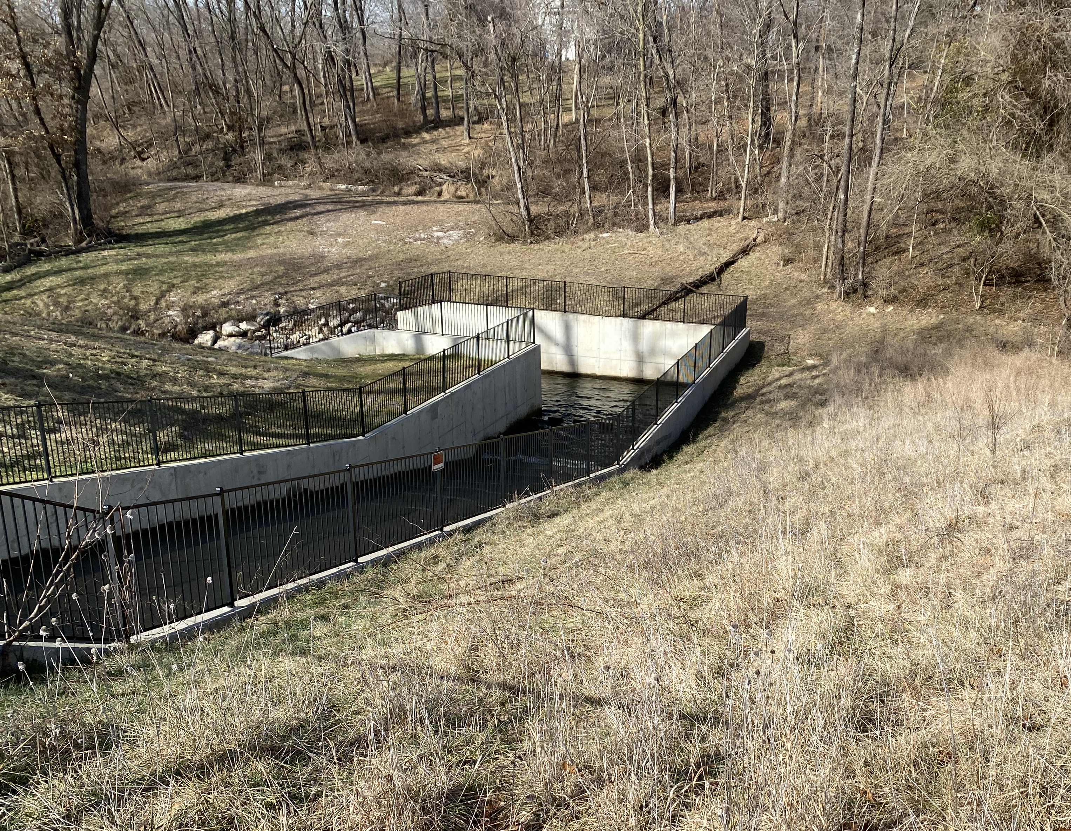
Dam Inspection completed September 2024
Please keep off the dam – we have had several trespassing issues over the last year, only authorized personnel should be on the dam
Dam Maintenance
Roy Wehling - Chair

Slide 13
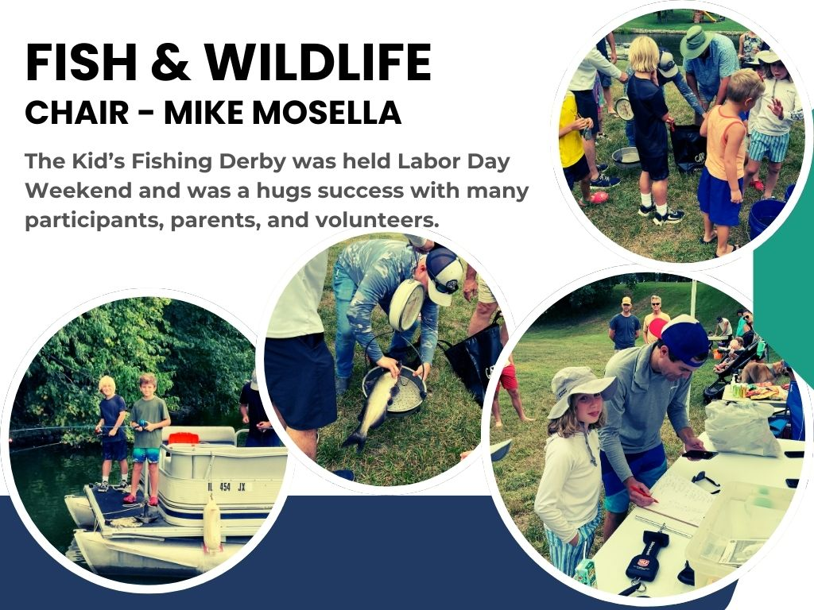

Slide 14
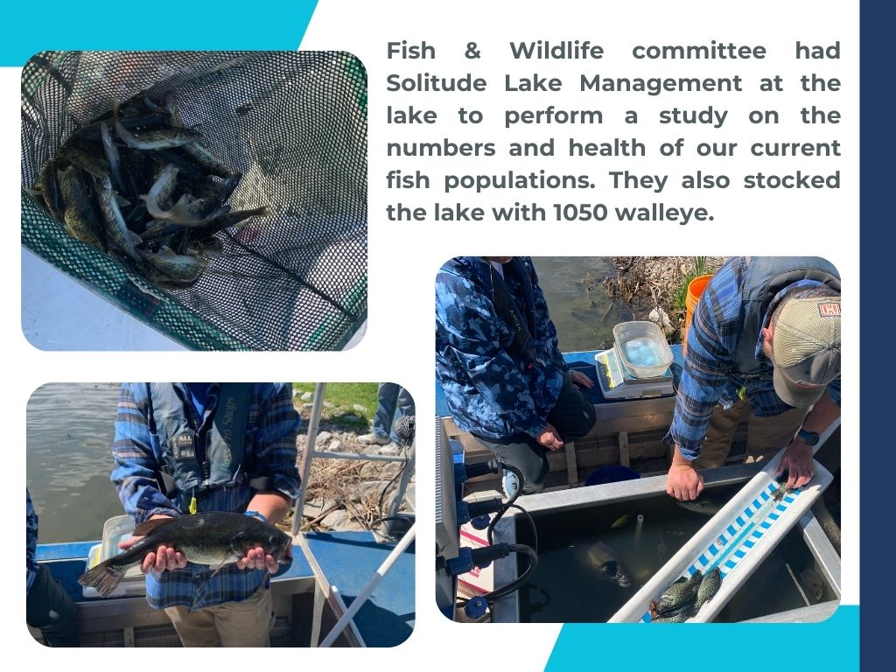

Slide 15
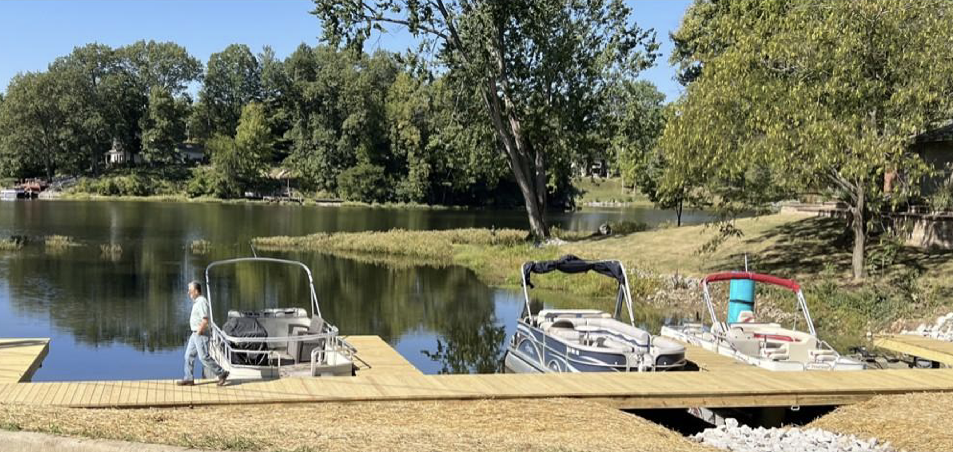
Legal Committee & Marinas
Josh Schumacher - chair
Marina Rental Fees Due March 15th

Slide 16


Slide 17


Slide 18
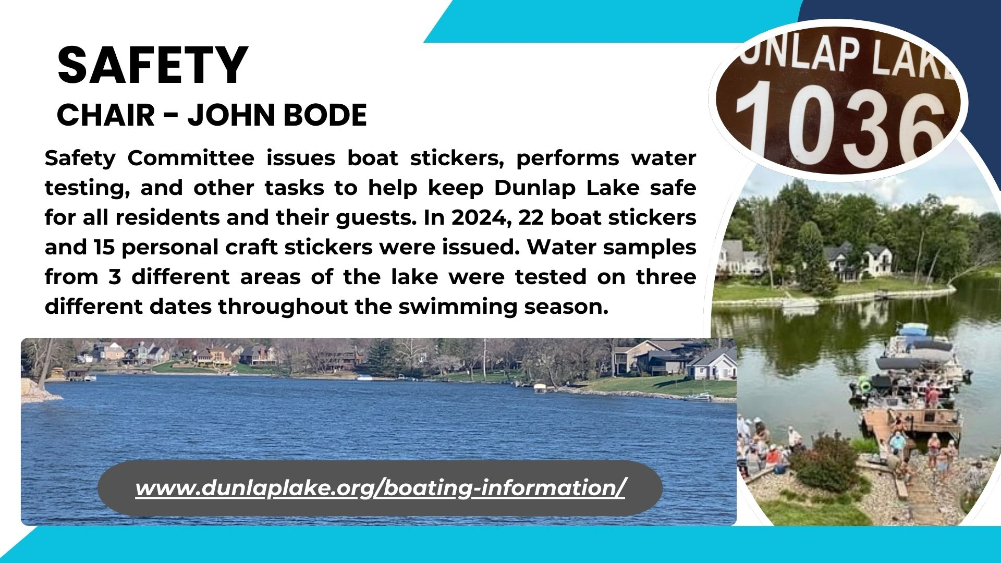

Slide 19
You do not need to be a board member to join a committee.
We are always looking for new volunteers and new events.
www.dunlaplake.org/volunteer/
Or email Carolyn@DunlapLake.org

Slide 20
2025 PROPOSED BUDGET
Rick Welle - Treasurer

Slide 21
Available Assets
FIRST MID SAVINGS (8217) |  | 01.31.25 |  |  |  | $115,226.29
FIRST MID MONEY MARKET (6232) | 2.5 | 02.14.25 |  |  |  | $28,020.53
FIRST MID CD (9881) | 3.92 | 02.14.25 |  |  | 06.02.2025 | $206,732.91
CPM Operations |  | 01.31.25 |  |  |  | $211,588.32
CPM Special Projects |  | 01.31.25 |  |  |  | $33,508.44
CPM Debit Card |  | 01.31.25 |  |  |  | $6,497.13
Busey Bank |  | 02.17.25 |  |  |  | $11,907.92
Total Liquid Assets |  |  |  |  |  | $613,481.54

Slide 22
2025 Operating Budget
Operating Fund |  | Current | Proposed
Income
Code | Description | Amount
 |  |  | (360 units x $500) | Total Billable units = 367
6310 | Assessment Income | $180,000 | $180,000
6314 | Lake Assessments | $168 | $168
Total |  | $180,168 | $180,168
Other Income
6770 | Misc. Owner Income | $1,500 | $1,500
6902 | Boat Stickers | $400 | $400
6910 | Interest Income | $400 | $7,000
Total Other Income |  | $2,300 | $8,900
Total Income |  | $182,468 | $189,068

Slide 23
2025 Budget (Admin)
 |  | Current | Proposed
Expenses
Administration
7010 | Management Fees | $6,000 | $6,000
7015 | Association Manager | $25,980 | $26,760
7020 | Heartlands Conservancy | $5,000 | $5,000
7140 | Accounting & Prof Fees | $700 | $700
7160 | Legal Fees | $10,000 | $10,000
7210 | Boat Stickers | $1,000 | $1,000
7220 | Computer and Software Exp | $1,000 | $1,000
7225 | Web Domain & Hosting | $600 | $600
7230 | Elections & Voting | $2,000 | $2,000
7240 | Financial Admin
7250 | Member Communications | $1,200 | $1,200
7280 | Office Supplies | $1,500 | $1,500
7285 | Onsite Postage | $900 | $900
7290 | Water Testing | $1,200 | $1,200
7310 | Miscellaneous Admin | $800 | $800
Total Admin |  | $57,880 | $58,660

Slide 24
2025 Fish and Wildlife + Social
 |  | Current | Proposed
Fish & Wildlife
8510 | Fish Toxins Lab Work | $750 | $750
8520 | Fishing Derby | $400 | $400
8530 | Fishing Tournament
8540 | Lake Stocking | $6,000 | $6,000
8550 | Traps & Bait | $1,000 | $1,000
Total Fish & Wildlife |  | $8,150 | $8,150
Social
7325 | Fireworks & Deposit | $8,000 | $8,000
7330 | Social Activities | $2,400 | $2,400
7335 | Member Meeting | $700 | $700
7340 | Bonfire | $250 | $250
7345 | Holiday Party | $500 | $500
Total Social |  | $11,850 | $11,850

Slide 25
2025 Grounds Budget
 |  | Current | Proposed
Grounds
8599 | Signage | $1,500 | $1,500
8610 | Lawn Care | $25,000 | $26,000
8630 | Dam Maintenance | $17,000 | $20,000
8635 | Dam Inspection | $2,500 | $3,000
8640 | Dam Repairs & Maintenance | $4,000 | $16,500
8650 | Silt & Erosion Eng, Survey & Design | $22,000 | $10,000
8655 | Silt & Erosion Interest Exp
8675 | Shoreline & Area Maintenance | $3,000 | $3,000
8680 | Inflow Maintenance | $8,000 | $8,000
8710 | 840 Property - Miscellaneous | $600 | $600
8720 | 840 Property - Mow & Landscape | $0 | $0
8730 | 840 Property - Utilities | $1,500 | $1,500
8800 | Miscellaneous Grounds | $2,000 | $2,000
8810 | Lake Debris Cleanup | $2,000 | $2,000
Total Grounds |  | $89,100 | $94,100

Slide 26
2025 Budget (Misc and Totals)
Operating Fund |  | Current | Proposed
Insurance
9010 | Insurance | $5,000 | $5,000
Total Insurance |  | $5,000 | $5,000
Taxes
9070 | Taxes | $4,000 | $4,000
Total Taxes |  | $4,000 | $4,000
Total Operations Expenses |  | $175,980 | $181,760
Operating Net Fund Total |  | $6,488 | $7,308

Slide 27
Loan Status Feb - 2024
ACCT | RATE | DATE | PAYMENT | BALANCE DUE | MATURITY DATE | ORIGINAL AMT
SPILLWAY (7012) | 3.99 | 01.23.25 | $5,000.00 | $420,214.16 | 03.23.27 | $492,000
ENGINEER (8559) | 3.99 | 01.23.25 | $3,500.00 | $424,088.04 | 03.23.27 | $465,000
BASIN (1850) | 7.75 | 02.14.25 | $8,900.00 | $849,554.73 | 02.14.28 | $1,103,790
TOTAL LOANS |  |  |  | $1,693,856.93 |  | $2,060,790

Slide 28
Reserve Financials
Reserve Fund
Income
6310 | Assessment Income | $252,000 | (360 units x $700)
Dam/Spillway Fund
 | Loan Payments |  | $60,000
Engineering Fund | Loan Payments |  | $42,000
Silt Retention Basin Fund
 | Loan Payments |  | $106,800
Total |  |  | $208,800
Net |  |  | $43,200

Slide 29
Final Notes
Liquid assets (cash) at $613 k
Less than 5% of collections are in arrears
Most of the outstanding collections are related to 2 properties
Dam Committee estimates $25 k will be needed for silo repairs (FY 26-27)
Through 11 months, Operations spent 64% of line item budget for FY 24-25
Remaining debt is at $1.7 m
About half ($844 k) is due in 2 years (currently at 2.99%)
Other half ($850 k) is due in 3 years (currently at 7.75%)

Slide 30
Master Plan Update
Toby Heddinghaus Chair

Slide 31
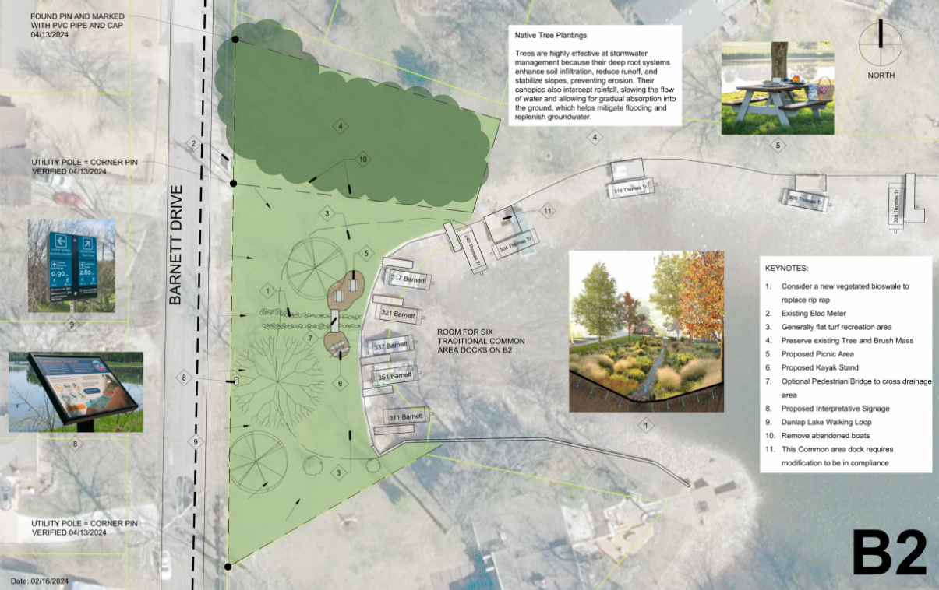
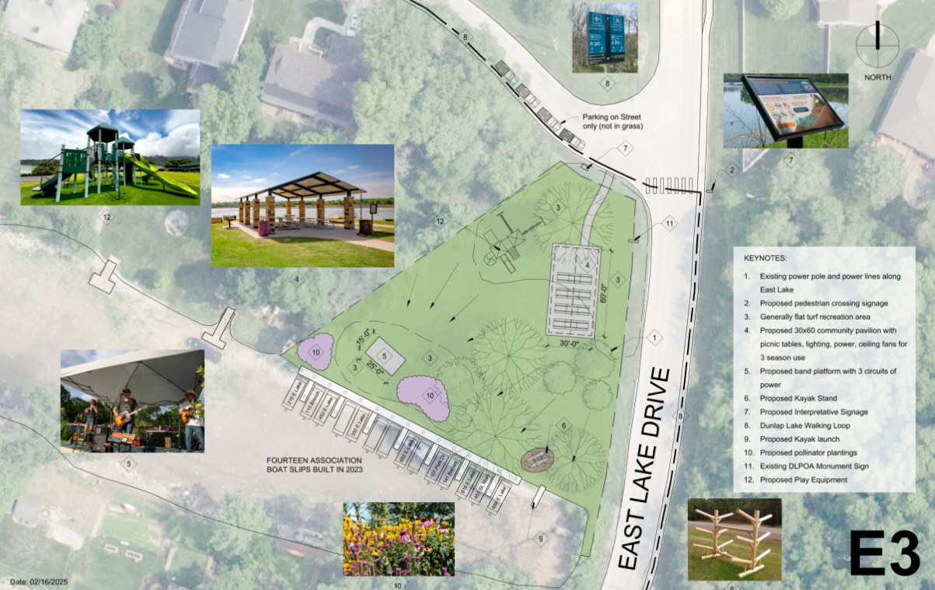
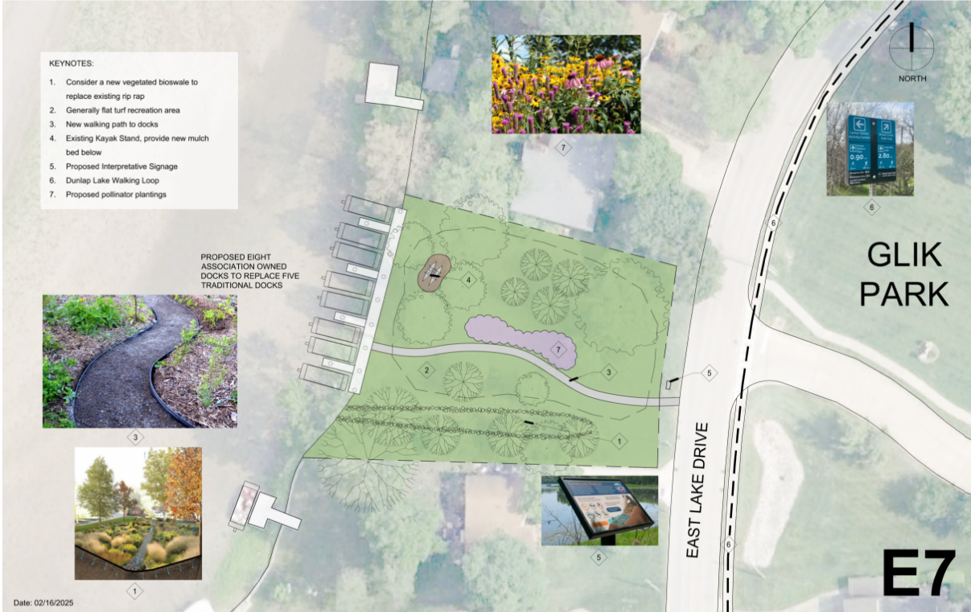
Common Area Visioning
Graphically document existing conditions, challenges, and opportunities at each Common Area
With input from the lake community, propose long term improvements that improve access, lake health, ease of maintenance, and recreation
Identify future projects and priorities as capital becomes available

Slide 32
Lake Depth mapping
We have baseline data of the retention basin, we will be able to monitor our sediment rate moving forward
The south end retention basin is doing its job, there is still work to be done
Cove A estimated 30K cubic yards of material removal
Cove B – mini retention basin to prevent silt entering the deeper portions of the lake
Still shallow areas in coves on the northern end of the lake – could be resolved with mechanically removing material where accessible
Will continue to work with SES to monitor and map lake

Slide 33
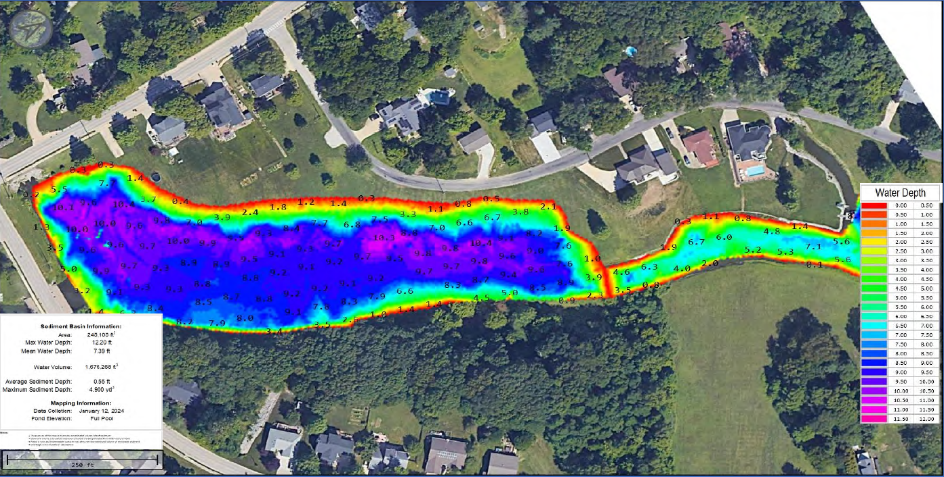
Retention Basin water Depth

Slide 34
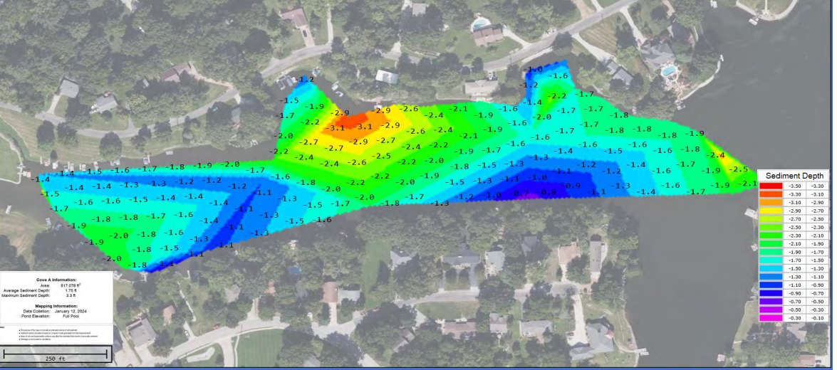
Cove A - Silt

Slide 35
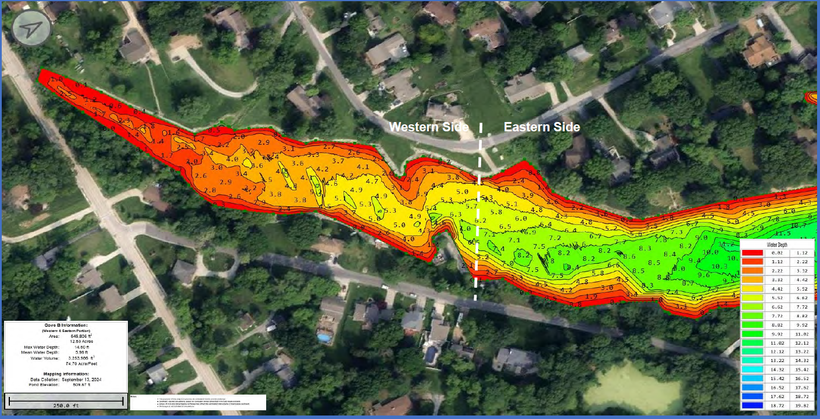
Cove B water Depth

Slide 36
Capital Financing
Andrew Reznack

Slide 37
Investigate Options
The Executive Team has been investigating potential options to improve our current loan rates as well as provide additional capital for projects – Discussions with the City have progressed around the possibility of establishing an SSA
What is an SSA?
Special Service Area
Enables communities to borrow money for capitol programs using a bond that is paid back via property tax bills levied by the county
Bond rates traditionally provide better rates than a standard loan as it is secured by the properties
Would this change my obligation to Dunlap Lake?
NO THIS WILL NOT INCREASE OBLIGATION to the HOA
Current assessments are $1200 per year, this would reduce your bill by $700 and move that to property tax bill, the new yearly lake assessment would be billed at $500

Slide 38
Questions
Are we required to do additional projects versus refinance existing debt
We can re-financing our existing debt as it was part of a master plan, but additional construction needs to be completed tied to our master plan
Will there be a vote?
There will need to be an advisory vote
Prior to having any vote we will set up several informational sessions to address any resident questions
Can I write this off on my taxes
The $700 will be treated as part of your tax bill
We suggest consulting with your tax professional
What are the next steps
Meeting with financial partners to align on expected terms
Meeting with Construction teams to determine scope of projects

Slide 39
Goals
Andrew Reznack

Slide 40
Goals
2023-24
2024-25
Financial
  Reduce Debt
  Maintain full funded capital reserves
  Stay within Operational budget
Future Projects
  Baseline our current depth levels via sonar
  Preliminary Roadmap for future projects
Operational
  Re-establish fish population
  Common Area Beautification
  Lake Clean up
Financial
  Reduce Debt
  Maintain full funded capital reserves
  Stay within Operational budget
Future Projects
  Proceed forward with long term financial investigation
  Finalize a plan to address remaining capital projects with construction teams
Operational
  Common Area Master plan feedback
  Lake Clean up

Slide 41

Thanks for Attending
Exciting things are happening at Dunlap Lake.
To join a committee please email
admin@dunlaplake.org or carolyn@dunlaplake.org

